Slide 1
Biology
Unit 5: Cells: Stability and Change
Lesson 2: Mitosis and Differentiation
Notes:
The learning experiences in this unit prepare students for the mastery of
Performance Expectations
LS1-4 Use a model to illustrate the role of cellular division (mitosis) and differentiation in producing and maintaining complex organisms.

Slide 2

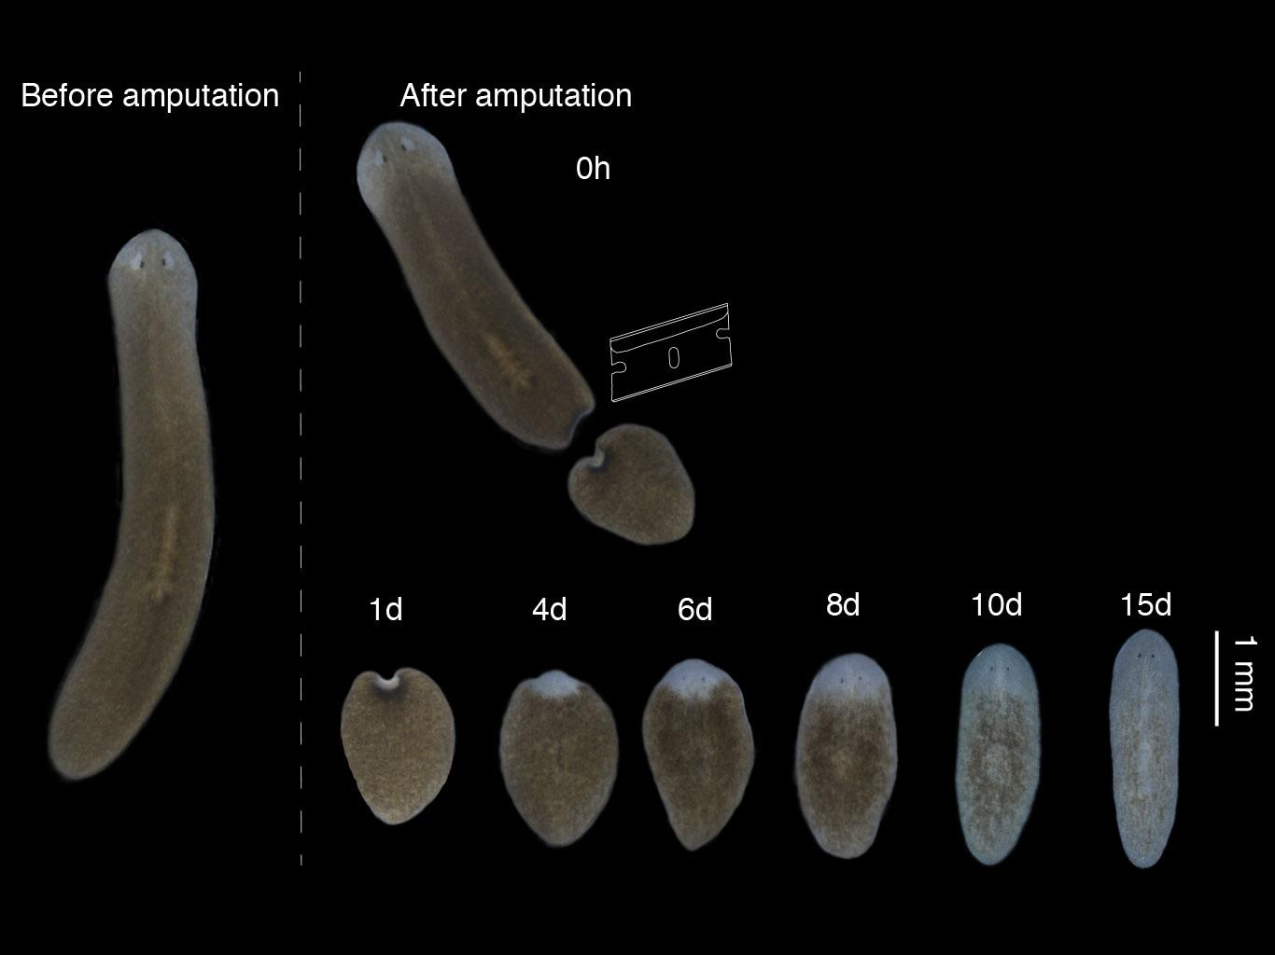
Can You Explain It?
Unit 5 Lesson 2
How do you think organisms like the planarian regenerate parts of their body?
How could humans benefit from this knowledge?
When planarians are cut into multiple pieces, each piece regenerates to form a complete organism.
Notes:
Build on Prior Lessons
In Lesson 1, students learned about the role of the cell cycle in the development and maintenance of multicellular organisms. Lesson 2 builds on these concepts as students explore mitosis, cell division, and differentiation.
Lesson Objective
To explain how mitosis and differentiation in cells contribute to the maintenance and reproduction of multicellular organisms.

Slide 3
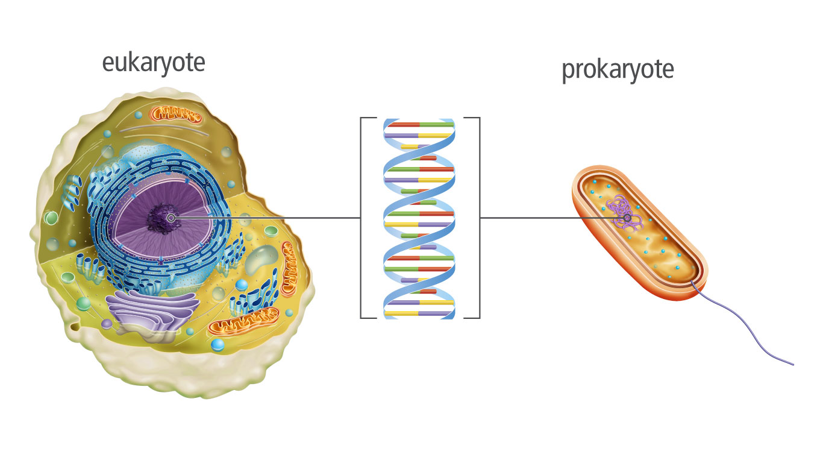
Unit 5 Lesson 2
Chromosomes
In all organisms, DNA is the genetic material that contains information that determines an organism's inherited characteristics.
DNA is the genetic material found in both prokaryotic and eukaryotic cells.
What does this model tell you about DNA?

Slide 4
Unit 5 Lesson 2
Chromosomes
A chromosome is one long continuous thread of DNA that consists of many genes.
Your body cells have 46 chromosomes each.
COLLABORATE
Describe to a partner what happens to the chromosome as the cell progresses into mitosis.

Slide 5
Unit 5 Lesson 2
Chromosomes
Each double-stranded DNA molecule makes one chromosome. During interphase, DNA is wrapped at regular intervals around proteins called histones, forming a structure called chromatin.
Interactions between parts of the histones further compact the DNA.
As the cell gets ready to divide, the DNA coils more and more tightly around organizing proteins, forming supercoiled DNA
The condensed, duplicated chromosomes can now be aligned and separated during cell division.
According to this model, what is the role of histones?

Slide 6
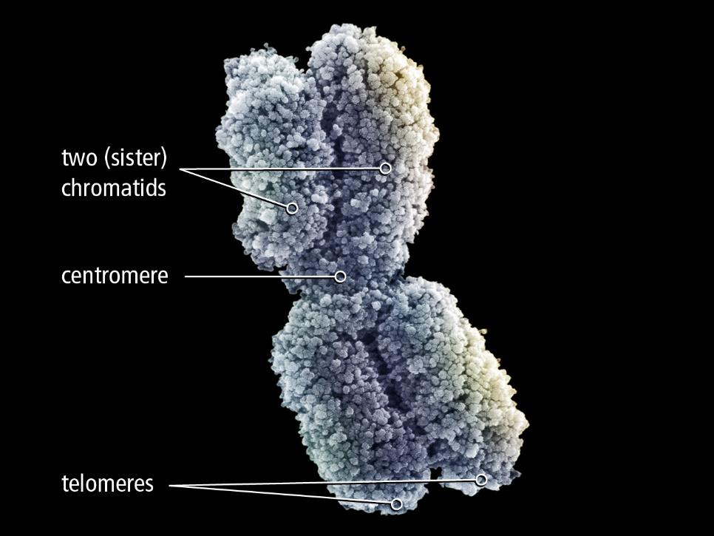
Unit 5 Lesson 2
Chromosomes
MODEL
Make a model to illustrate the meanings of the terms DNA, molecule, chromosome, chromatin, chromatid, and centromere.
A chromosome is made up of two sister chromatids held together at the centromere.

Slide 7
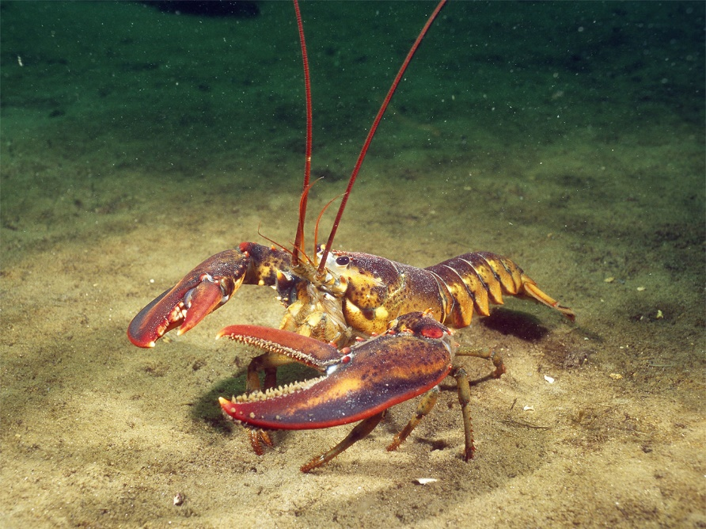
Chromosomes Engineering
Unit 5 Lesson 2
The ends of chromosomes form structures called telomeres
The loss of telomeres over time has been linked to aging in organisms.
Scientists are currently studying ways telomerase could be used to slow down aging and fight diseases like cancer. How might these studies influence society?
Lobsters are referred to as "immortal" because they do not appear to die from old age.

Slide 8
Unit 5 Lesson 2
Chromosomes
EXPLAIN
DNA must be coiled into special structures before a cell divides. Why do you think it is necessary for the DNA to be structured this way before cell division occurs?
Every cell in your body originated from one cell. What does this mean about the DNA in each of your body cells?

Slide 9
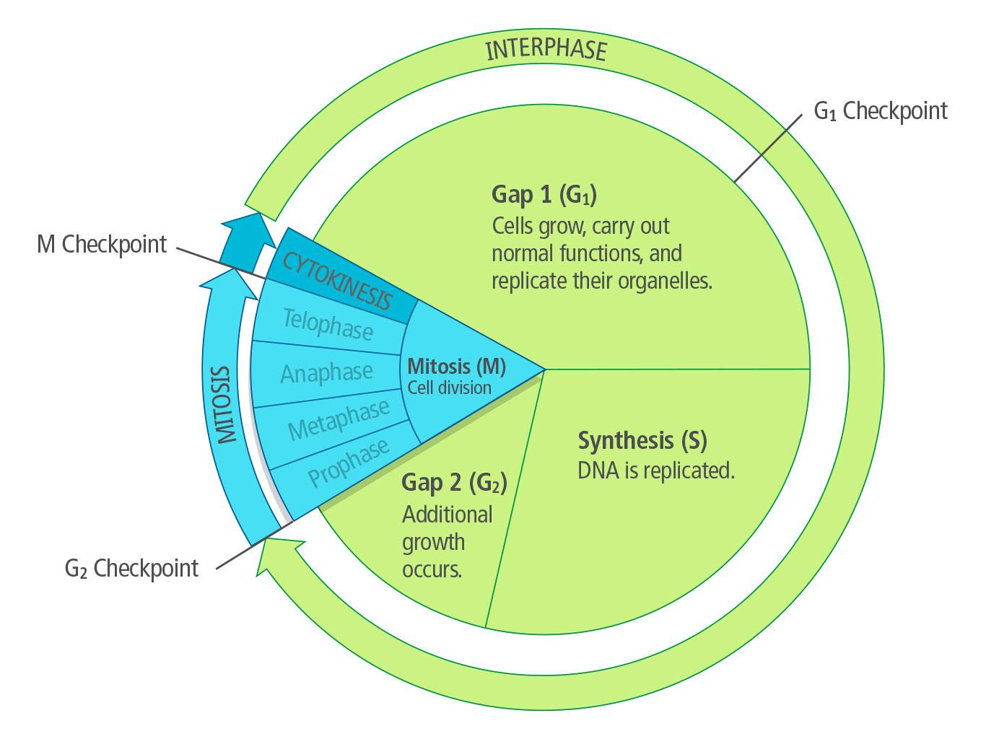
Unit 5 Lesson 2
Mitosis and Cytokinesis
Interphase plays an important role in preparing the cell to divide.
Mitosis is the stage during which cell division takes place.
At the end of mitosis, the process of cytokinesis divides the cell cytoplasm.

Slide 10

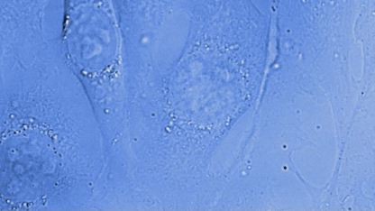
Unit 5 Lesson 2
Mitosis and Cytokinesis
Observe a cell dividing via mitosis and cytokinesis.

Slide 11
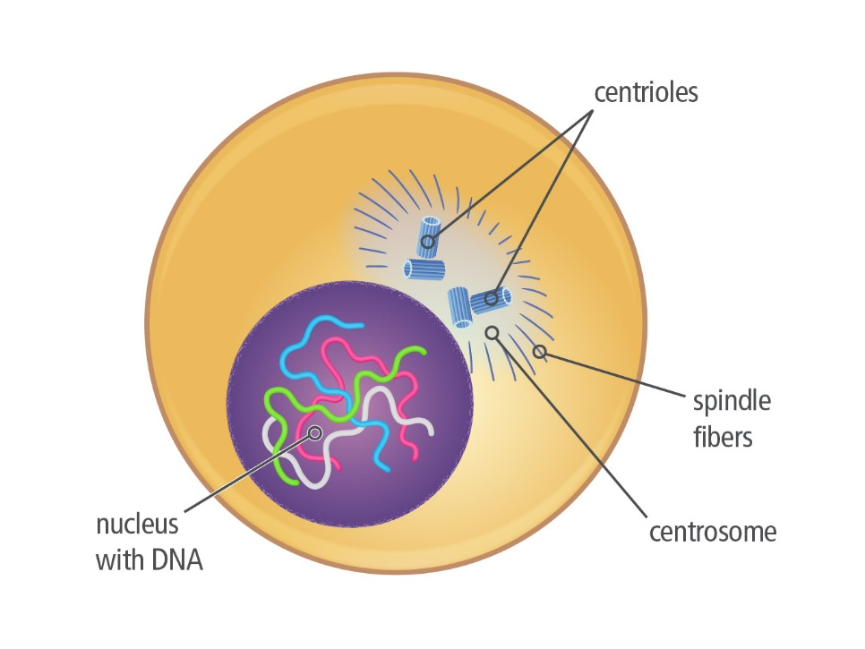
Unit 5 Lesson 2
Mitosis and Cytokinesis
COLLABORATE
Discuss this question with a partner: How do you think the cell divides its DNA evenly to give each daughter cell an identical copy of the genetic material?
Centrosomes contain structures called centrioles. Spindle fibers are organized at the centrosome.

Slide 12
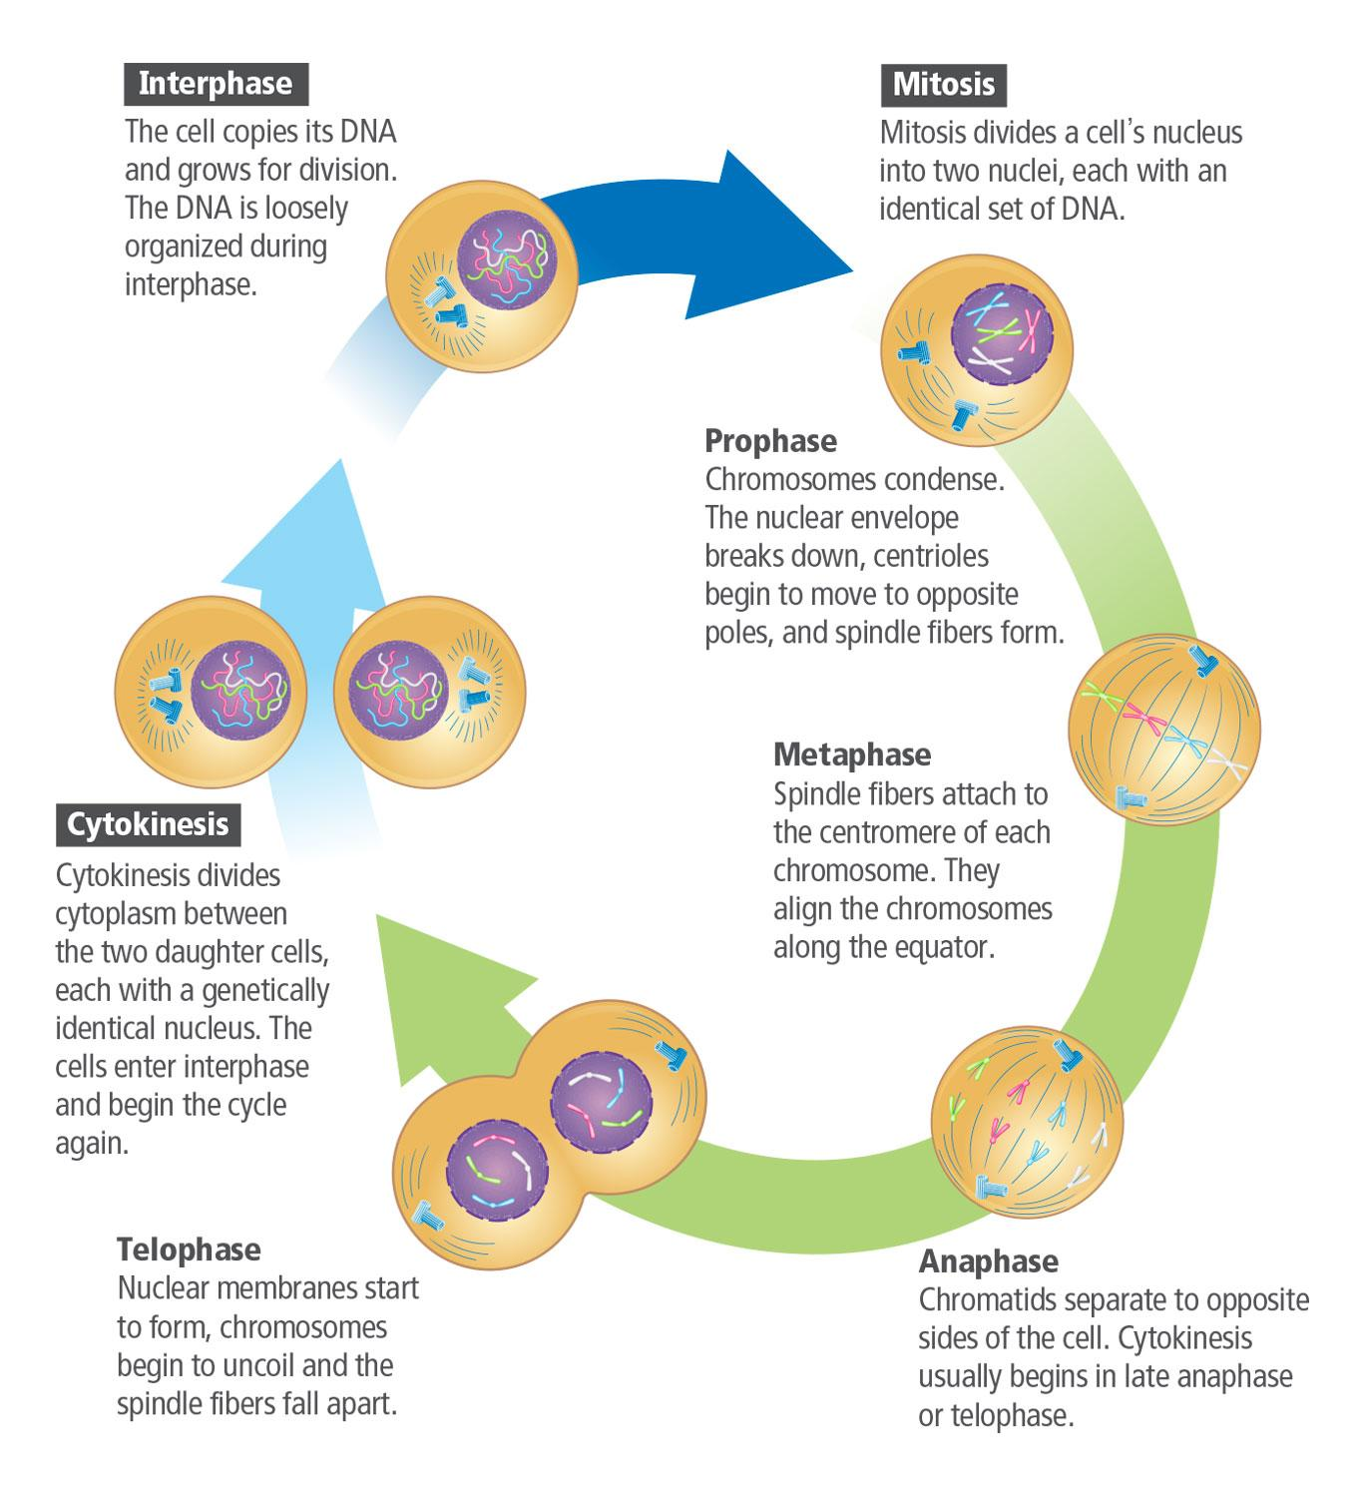
Unit 5 Lesson 2
Mitosis and Cytokinesis
System and System Models
ANNALYZE
What mechanisms ensure that each cell receives an identical set of DNA during mitosis?
Use evidence from the Cell Cycle Model to support your answer.

Slide 13
Unit 5 Lesson 2
Mitosis and Cytokinesis
System and System Models
ANNALYZE
Human cells have 46 chromosomes. How many chromosomes should be present during the G₂ phase of the cell cycle?
How many should be in each daughter cell after cytokinesis? Explain your answers.
How would you describe the phases of mitosis in your own words?

Slide 14
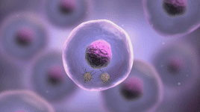
Unit 5 Lesson 2
Mitosis and Cytokinesis
Another way to model mitosis is with an animation.

Slide 15

Mitosis and Cytokinesis Hands-On Lab: Animating Mitosis
Unit 5 Lesson 2
Make a flipbook representing mitosis in action. As you flip the pages, the images will appear to move right before your eyes.

Slide 16
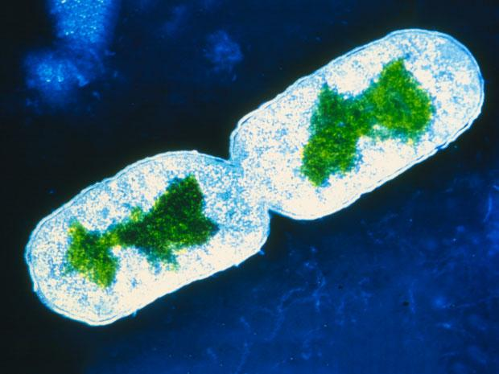
Unit 5 Lesson 2
Mitosis and cytokinesis
Asexual reproduction can occur relatively quickly.
Prokaryotes and some eukaryotes reproduce asexually.
The offspring that result are, for the most part, genetically identical to each other and to the original single-celled parent.
In binary fission, the original cell divides into two genetically identical cells.

Slide 17
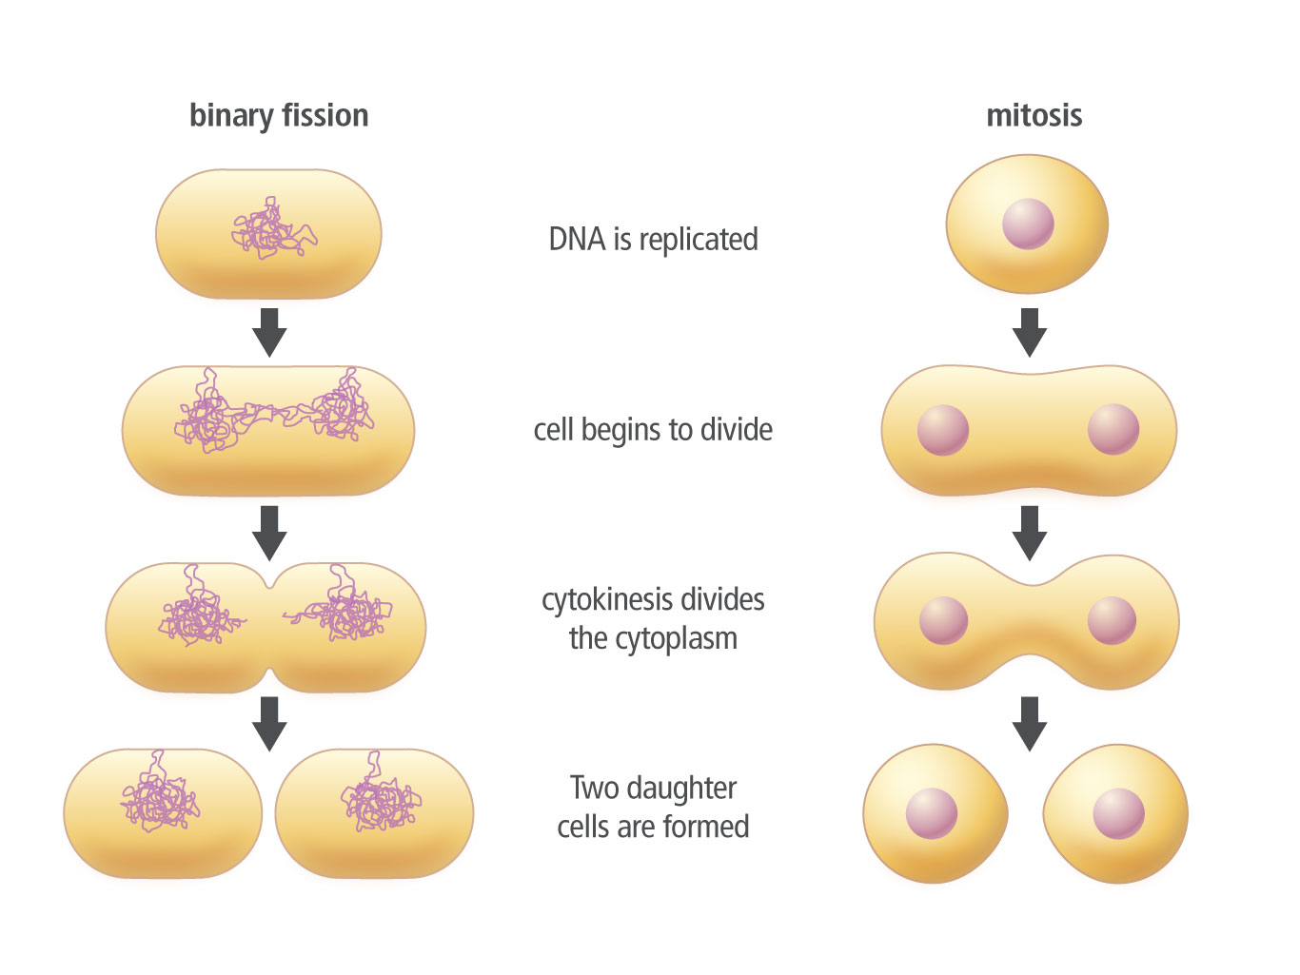
Unit 5 Lesson 2
Interacting Systems in Organisms
In binary fission, the original cell divides into two genetically identical cells.
MODEL
Construct a Venn diagram comparing binary fission and mitosis.

Slide 18
Unit 5 Lesson 2
Mitosis and Cytokinesis
PREDICT
Although bacteria and other single-celled organisms can produce genetically identical offspring, they sometimes still exchange DNA by passing it from bacterium to bacterium.
What might be the advantage of exchanging DNA in this way?

Slide 19
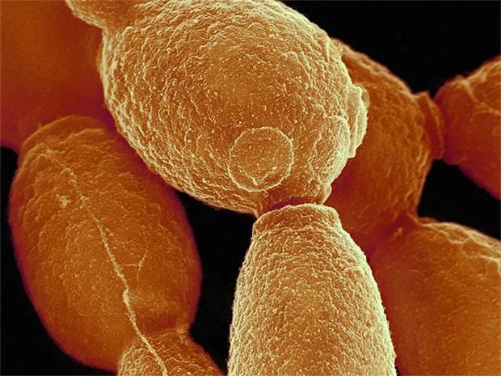
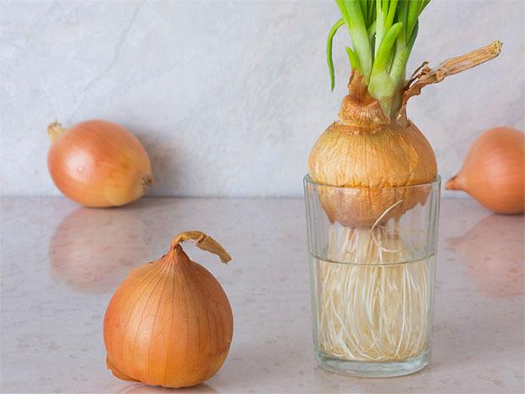
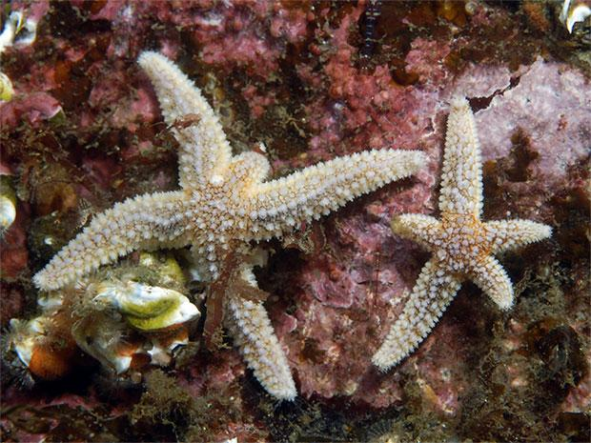
Mitosis and Cytokinesis
Unit 5 Lesson 2
Forms of Mitotic Reproduction
Budding
Vegetative Reproduction
Fragmentation
COLLABORATE
If you wanted to grow a crop for human consumption, which process do you think would be best – sexual or asexual reproduction? Write your argument and explain it to a partner.

Slide 20
Unit 5 Lesson 2
Mitosis and Cytokinesis
MODEL
Develop a model to illustrate how mitosis results in two genetically identical daughter cells.
Include chromosomes in your model, and use different colors, materials, or symbols to show how the cell duplicates, organizes, and separates chromosomes during interphase and mitosis.

Slide 21
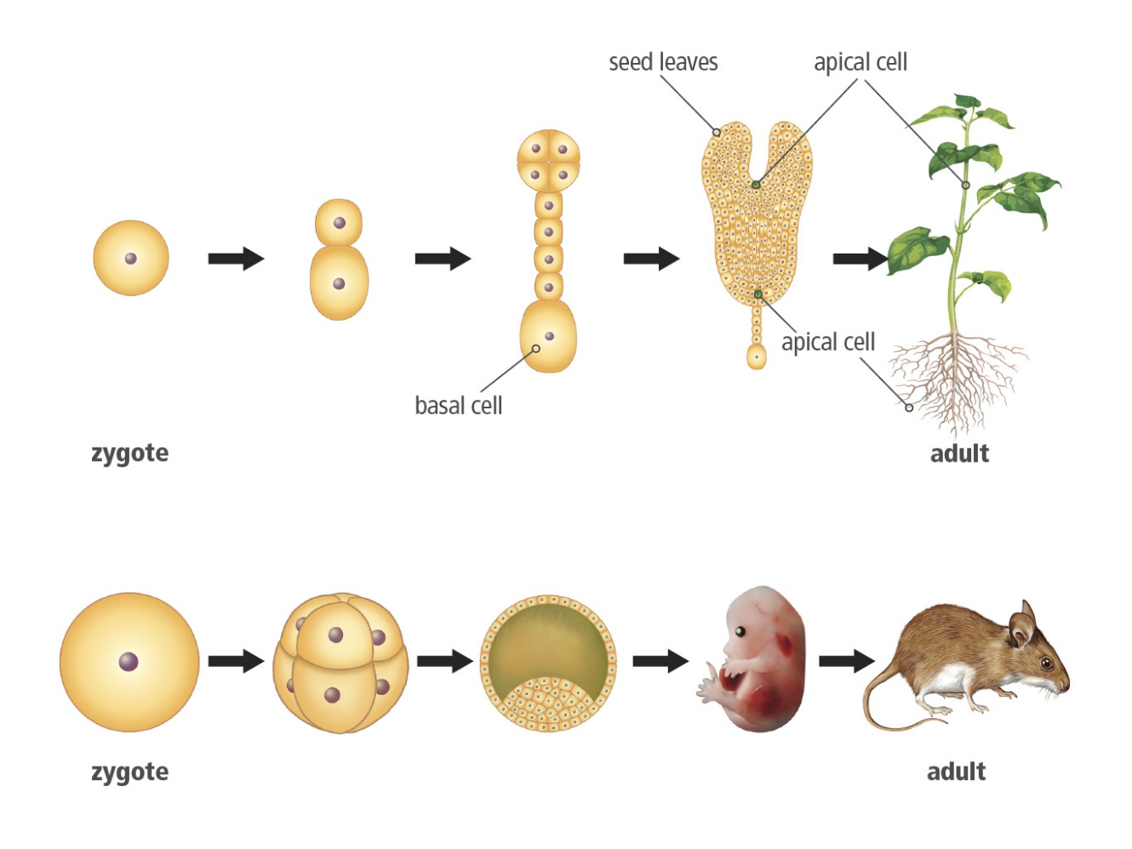
Cell Differentiation
Unit 5 Lesson 2
The zygote undergoes a series of divisions to produce a mass of cells that then become specialized.
Cell differentiation is the process by which a cell becomes specialized for a specific structure and function during the development of a multicellular organism.
Cell differentiation in a plant and an animal.

Slide 22
Unit 5 Lesson 2
Cell Differentiation
System and System Models
Compare the model of cell differentiation in plants to the model of cell differentiation in animals.
What are the differences, and what are the similarities?

Slide 23
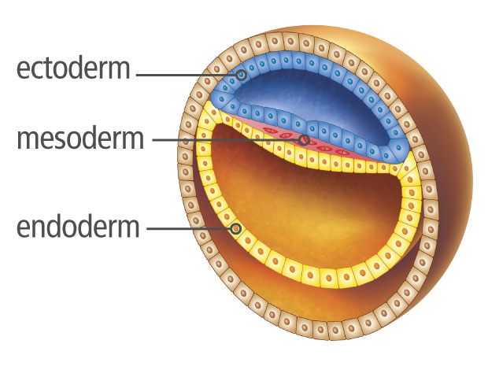
Cell Differentiation
Unit 5 Lesson 2
In animals, an egg undergoes many divisions after it is fertilized. The resulting cells migrate to a specific area and begin to differentiate, forming a hollow ball.
Some animals develop from only two cell layers.
Vertebrates, including humans, develop a third layer of cells called the mesoderm, between the inner and outer layers.
This standard model of development varies from species to species
The gastrula is the embryo stage that develops three layers of cells: the ectoderm, mesoderm, and endoderm.

Slide 24
Cell Differentiation Modeling Induction in Embryos
Unit 5 Lesson 2
Design a model to show how inducing chemicals trigger cell differentiation in a developing embryo.

Slide 25
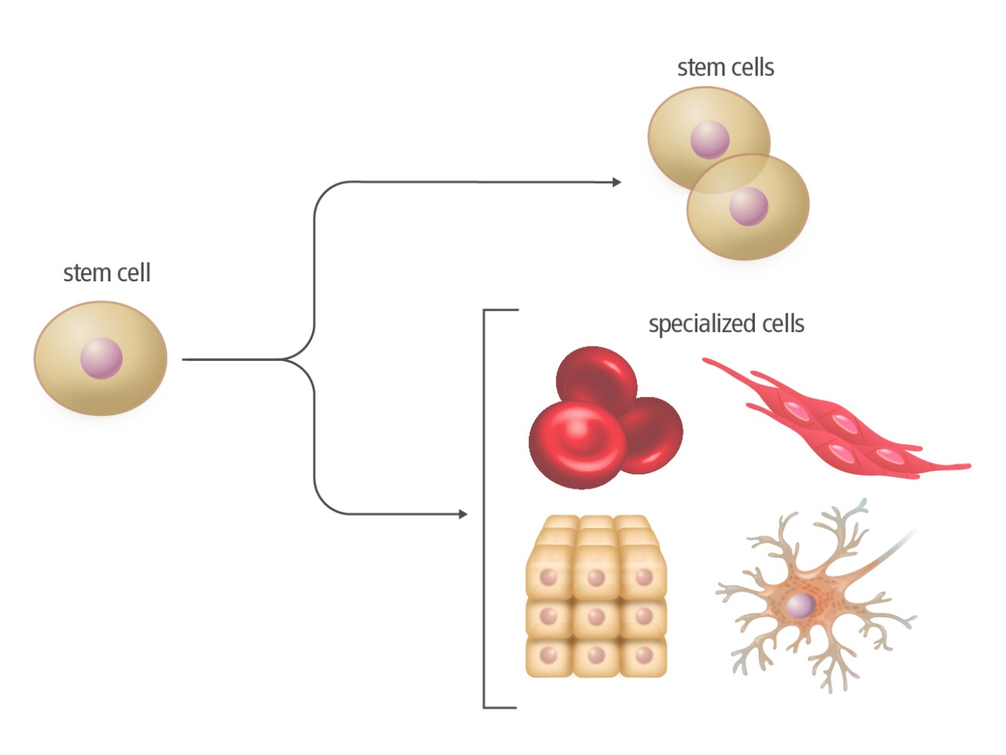
Cell Differentiation
Unit 5 Lesson 2
Specialized cells develop from a type of cell known as a stem cell.
Classified by their potential to develop into differentiated cell types of different tissues.
Classified by their origin, as either adult or embryonic.

Slide 26
Unit 5 Lesson 2
Cell Differentiation
What are advantages or disadvantages of using adult stem cells for research or medical purposes?
What are advantages or disadvantages of using embryonic stem cells for research or medical purposes?
COLLABORATE
Write a list of tradeoffs you might consider when deciding whether to use stem cell treatments or traditional treatments to treat a disease like diabetes. Compare your list to a partner’s list and mark the common items.

Slide 27
Unit 5 Lesson 2
Cell Differentiation
A gene is a segment of DNA that stores genetic information.
Each cell expresses only the specific genes it needs to carry out its function.
When a gene is expressed, the instructions within that segment of DNA are used to make proteins that carry out specific functions within the cell.

Slide 28
Unit 5 Lesson 2
Cell Differentiation
MODEL
Make a model to illustrate how an organism develops from a zygote to a fully grown adult.
In your model, include media and text to explain fertilization, cell division, and cell differentiation.

Slide 29
Unit 5 Lesson 2
Continue Your Exploration
Choose one of the paths below to continue your exploration:
Mitosis Under the Microscope
Studying Limb Regeneration
Cytokinesis in Plant and Animal Cells
Modeling Induction in Embryos

Slide 30
Can You Explain It?
Unit 5 Lesson 2
Construct an explanation for how cell division and differentiation help organisms such as planarians regenerate parts of their body. Your response should answer the following questions.
What is the role of mitosis in regenerating tissues?
How are stem cells involved in the process of regeneration?
What is the role of cell differentiation in the development of the organism?
How could knowledge of this process be used to help humans?

Slide 31
Image Credits
Unit 5 Lesson 2
lava rock, plant ©Design Pics/Getty Images; lava rock, plant ©Design Pics/Getty Images; chromosome ©Science Source/BIOPHOTO ASSOCIATES/Getty Images; cells budding ©SPL/Science Source; bacterial cells dividing ©Science Source; onion in water ©Olena Ukhova/Shutterstock; sea stars ©Ecostock RF/Lawson Wood/age fotostock; planarian regeneration ©Cristina González-Estévez, Leibniz Institute on Aging (FLI), Jena, Germany; lobster ©Andrew J. Martinez/Science Source; mitosis in cell division video ©SPL/Michael A. Desantis/Science Source

